Slide 1
Artificial Intelligence (AI) and Quantum Computing

Slide 2
Artificial Intelligence (AI) and Quantum Computing are two transformative technologies. Their integration has the potential to solve complex problems that are currently infeasible with classical computing methods.
Quantum Computing
Definition: Quantum computing is a field of computer science that uses quantum mechanics to solve complex problems that are beyond the capabilities of classical computers. Quantum computers use specialized hardware and algorithms to take advantage of quantum mechanical properties like superposition and quantum interference.

Slide 3
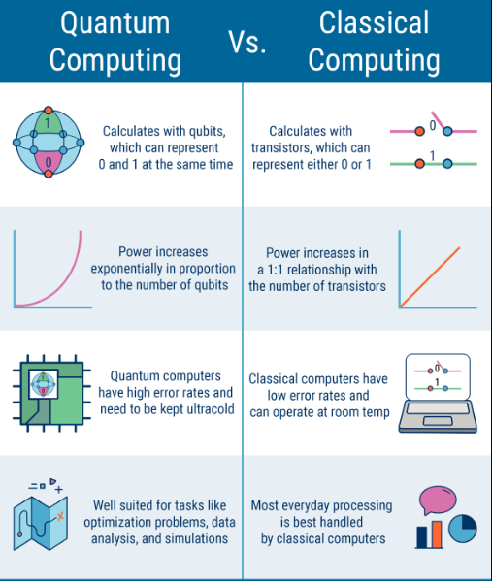

Slide 4
Core Concepts:
Qubits: Quantum bits that can exist in superposition (both 0 and 1 simultaneously).
Superposition: Enables the representation of multiple states at once.
Entanglement: Qubits become interconnected so that the state of one qubit affects the state of another, even over long distances.
Quantum Gates: Perform operations on qubits, manipulating their probabilities.
Advantages:
Exponential speedup for specific problems (e.g., factorization, optimization).
Solving problems intractable for classical systems (e.g., large-scale simulations).

Slide 5
Intersection of AI and Quantum Computing
Potential Synergies:
Optimization Problems:
Quantum computers can solve optimization problems efficiently, aiding in AI model training and hyperparameter tuning.
Speeding Up Machine Learning:
Algorithms like Quantum Support Vector Machines (QSVM) and Quantum Neural Networks (QNN) aim to leverage quantum speedups.
Processing Large Datasets:
Quantum-enhanced methods can handle big data faster and more efficiently than classical systems.
Boosting AI Algorithms:
Quantum algorithms such as Grover's and Shor's can accelerate data search and cryptographic tasks used in AI.

Slide 6
Challenges
AI and Quantum Integration:
Developing quantum algorithms for AI tasks.
Translating classical data into quantum formats.
Training AI professionals with quantum expertise.
Applications of Quantum Computing
Optimization Problems
Solving logistics and supply chain challenges by finding optimal routes and configurations (e.g., traffic flow, fleet management).
Portfolio optimization in finance for better investment strategies.
Cryptography
Breaking classical encryption systems (e.g., RSA) using Shor’s algorithm.
Developing quantum-resistant cryptographic methods (post-quantum cryptography).

Slide 7
Material Science
Simulating molecular and atomic interactions for new material discovery (e.g., superconductors, batteries).
Understanding complex chemical processes to advance clean energy solutions.
Drug Discovery and Biophysics
Simulating protein folding and drug interactions at an atomic level to develop treatments faster.
Artificial Intelligence Enhancement
Quantum machine learning for faster training and improved accuracy.
Speeding up processes like data clustering and pattern recognition.
Climate Modeling
Simulating complex climate systems to predict environmental changes.
Developing strategies to combat climate change.

